Slide 1


Charging Buddy
Project Guide:
Prof. D. P. Kapse
Authors:
Sagar Ambilpure
Aditya Chavan
Uzair Chhapra

Slide 2

Introduction
Mobile phone is our means to remain connected. While the phones have progressively got more powerful processors and large touch screen interfaces, their power requirement has increased correspondingly. Unfortunately, battery technology has not been growing at a comparable pace. Hence, there is a need to frequently charge the batteries. While travelling, people face a common problem of charging electronic appliances. Most of the cell phone users have experienced having their cell phones run out of battery when they are not near a charging outlet. Our system provides such users an elegant solution to this widespread problem.

Slide 3
Why do we need this?
Currently, when a user's cell phone runs out of battery and there is no charging outlet nearby there very little or nothing that the user can do about it. Even if a charging outlet is available nearby one would have to stay close to the charging outlet until the phone is charged. Our system would provide such users with a solution which would enable them to do other things while the cell phone is being charged without worrying about their phones being stolen. Our charging stations would be located at various public places which would be available for all the registered users. These charging stations would be like vending machines i.e. fully automated using IoT. These charging stations, when placed in stores, would attract more customers & increase dwell time which would consequently increase sales.

Slide 4

Problem Statement
The Problem Statement here is to develop a convenient solution for the widespread issue of mobiles being low on power outside the consumer’s homes and offices.
Mobile phones’ battery getting discharged is a massive issue for every consumer whenever they are on the go.

Slide 5
Objectives
To implement a mobile application to show position of our Mobile Charging station on the map.
To make a Mobile Charging Station and secure it’s open and close locker mechanism using IOT.
To develop a server for our application from where booking requests and user history can be managed.
To provide an API to shopping mall stores for integrating user purchase details with our application.
To provide product recommendations based on purchase history to user in our Charging Station partnered stores.

Slide 6
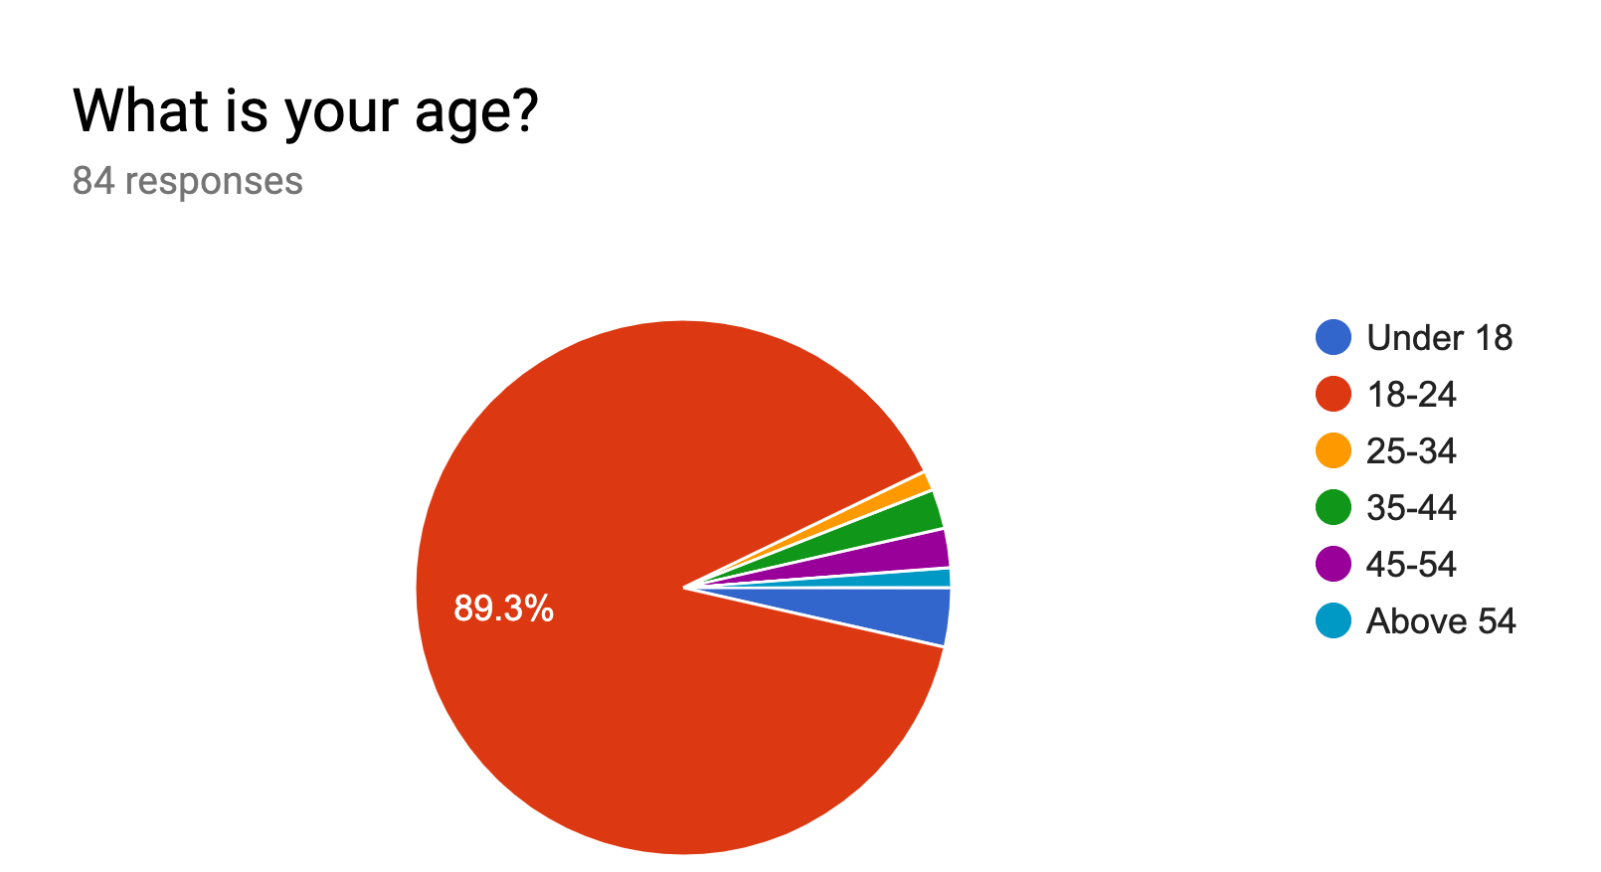

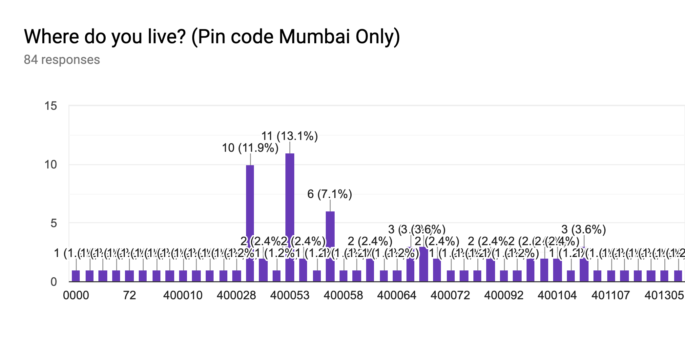
Our User Demographics
The survey we conducted gave us the following details about our potential customers:
Age groups of our prospective users.
Area codes of our prospective users.

Slide 7
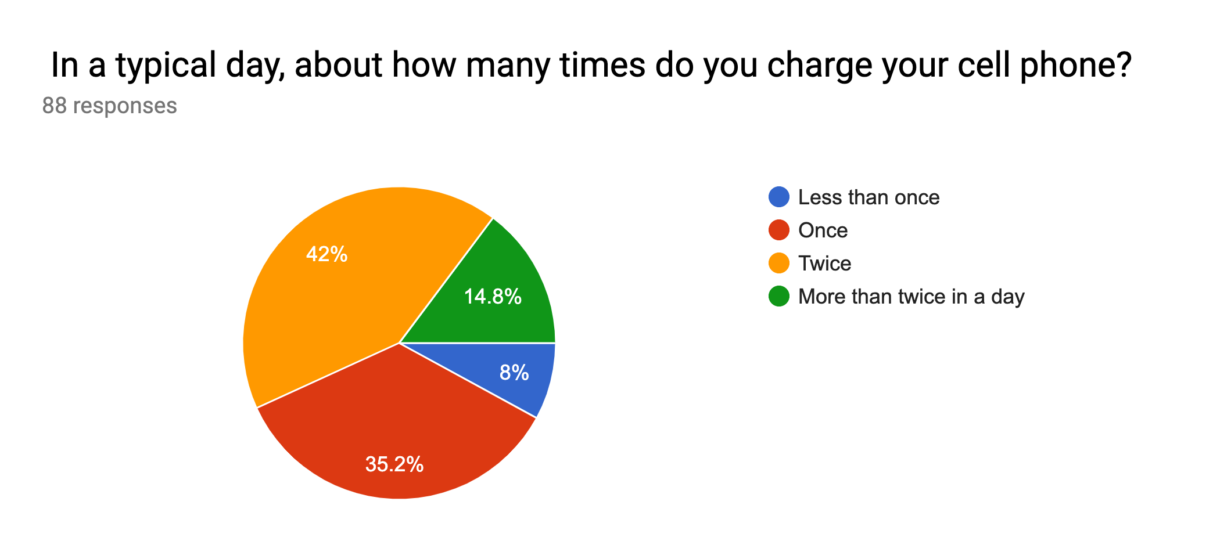
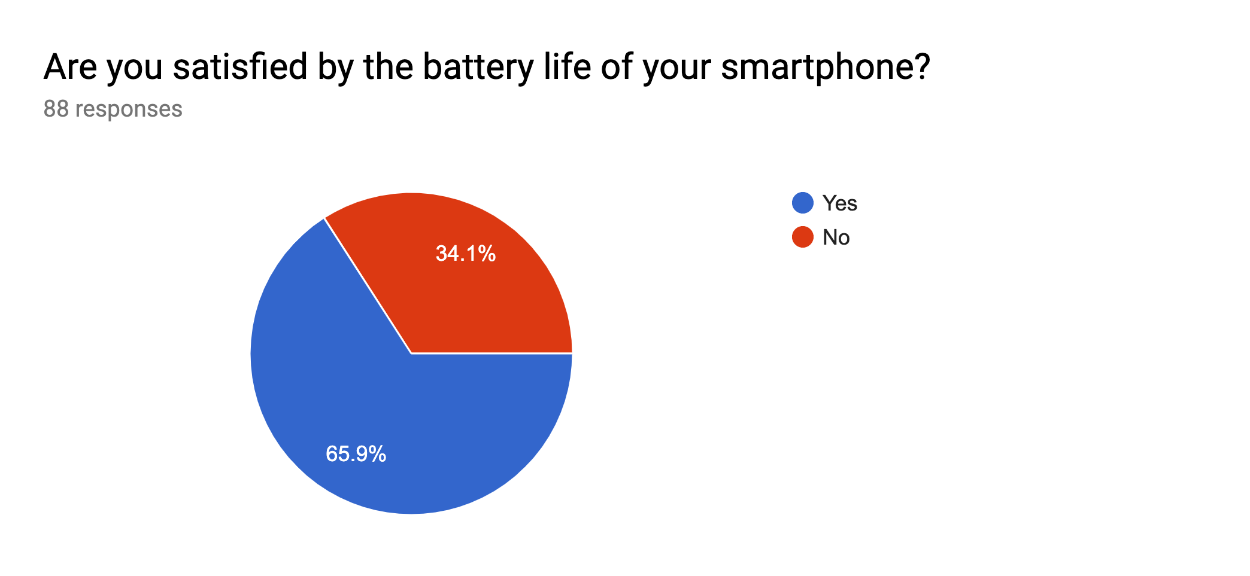
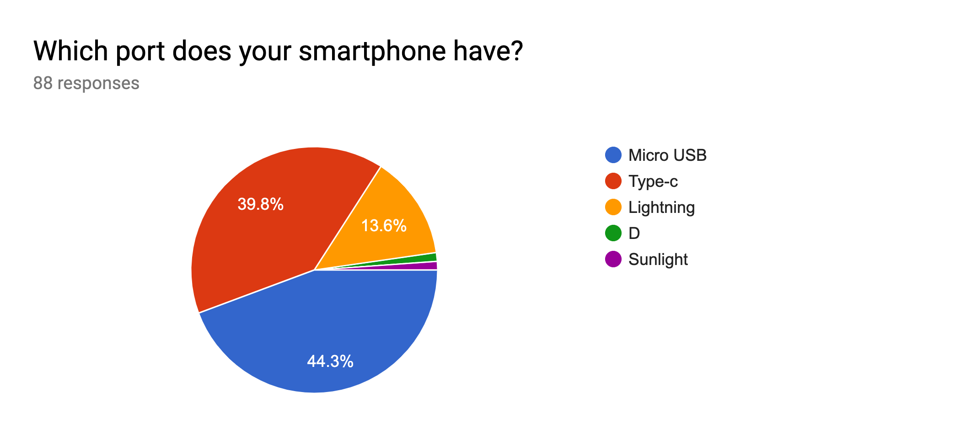
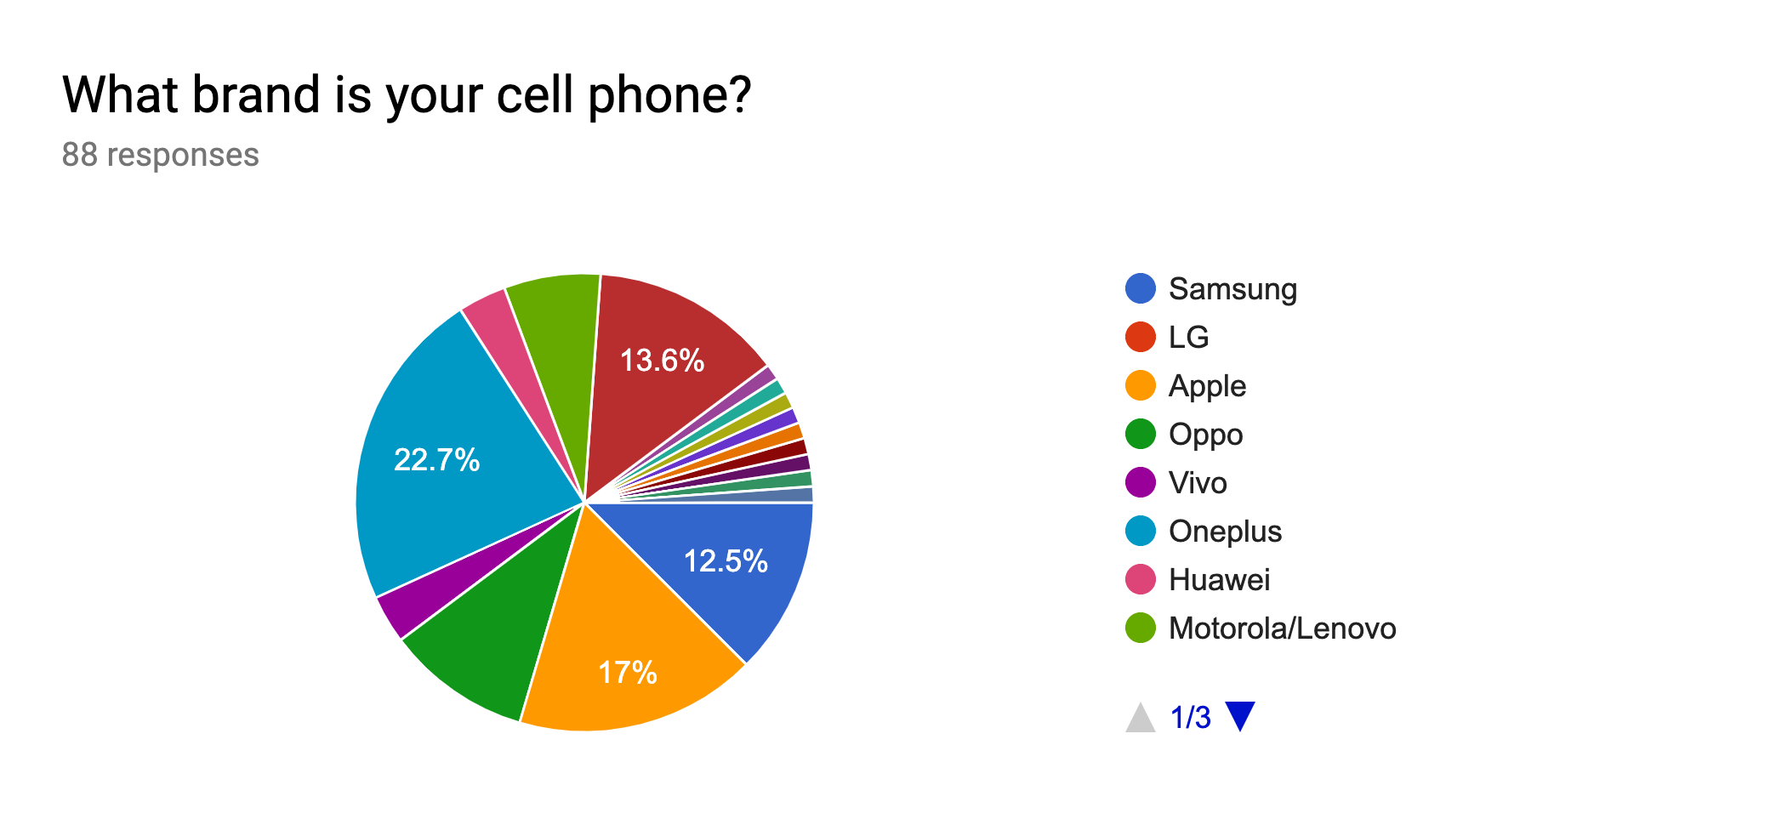
Market Research

Slide 8
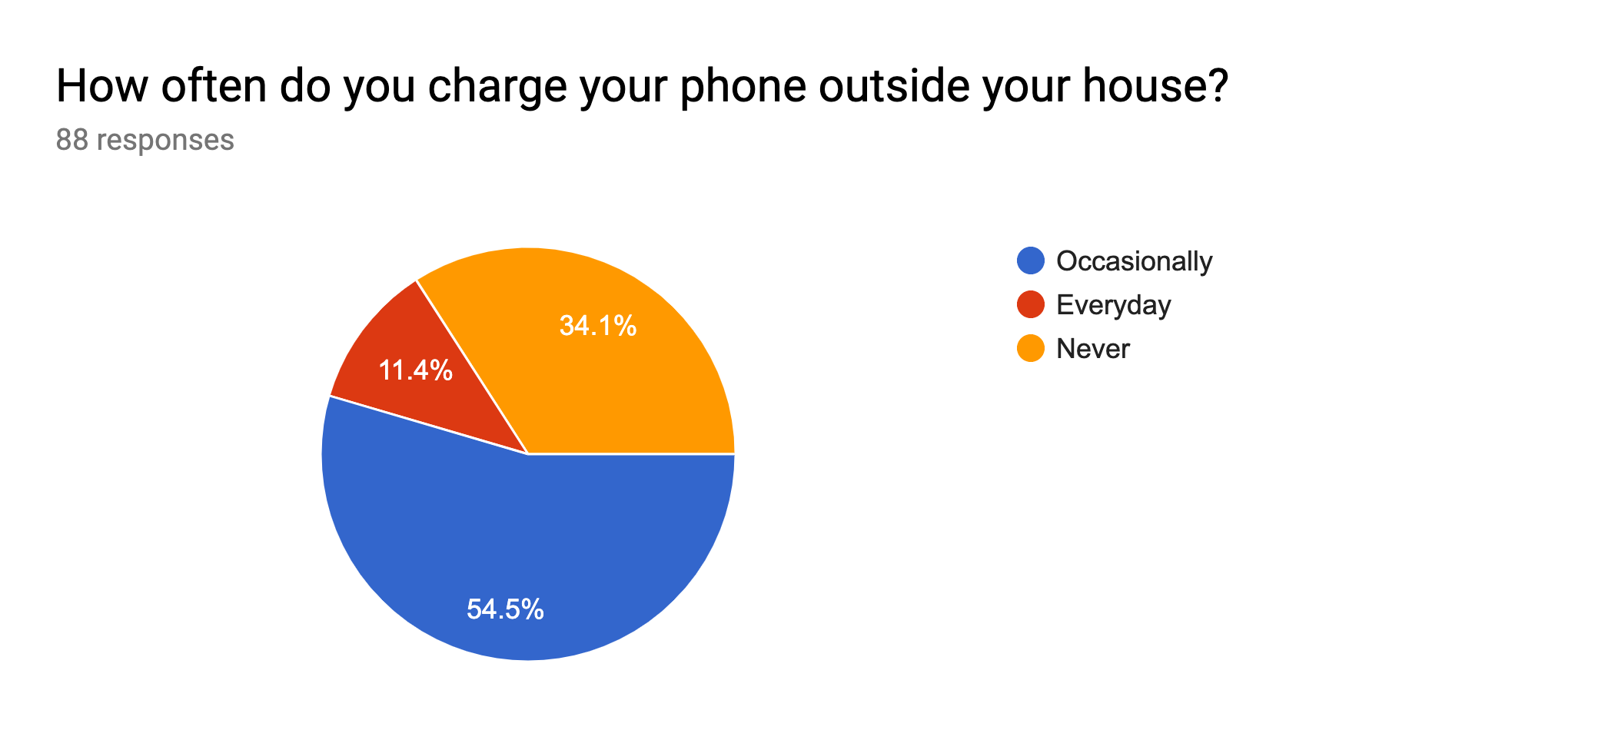
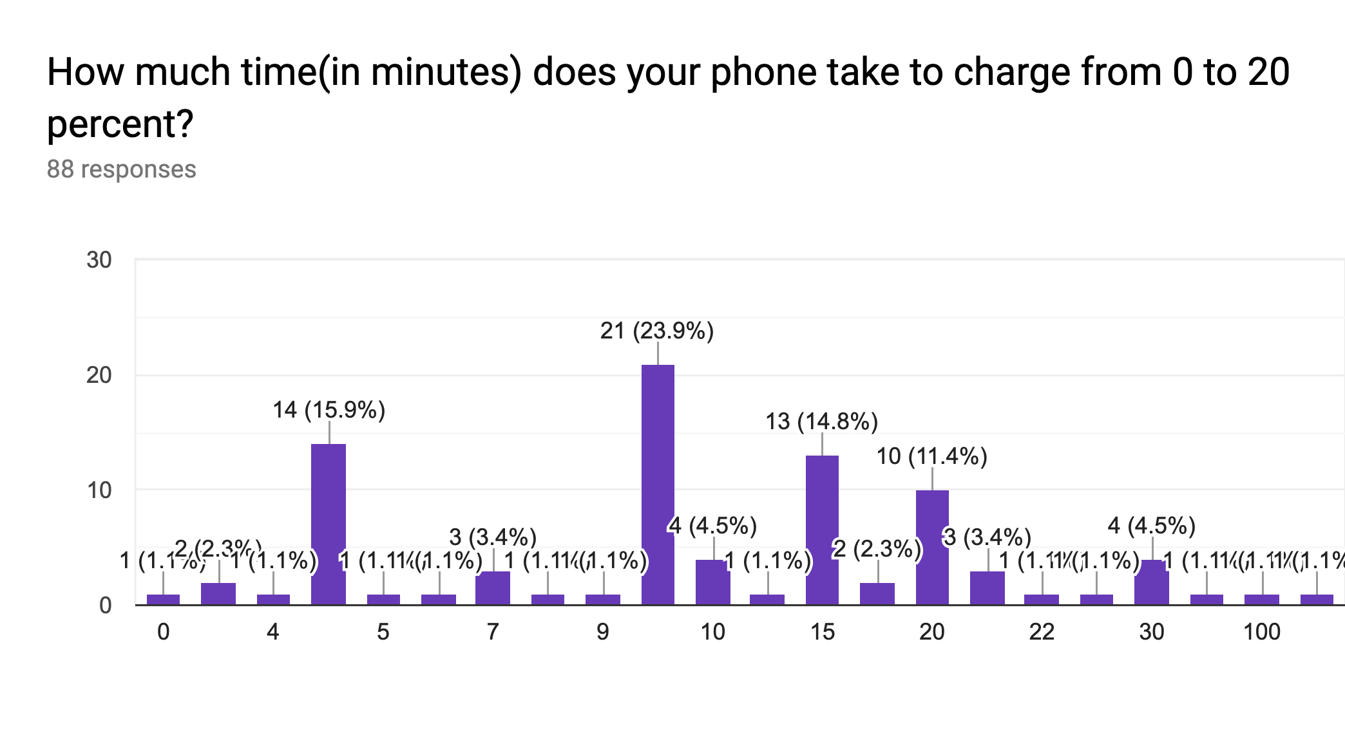
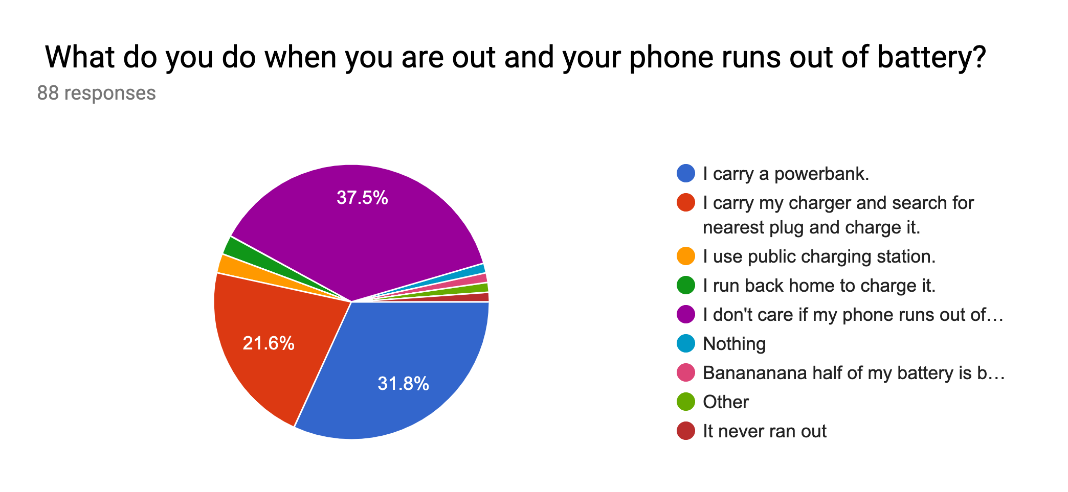
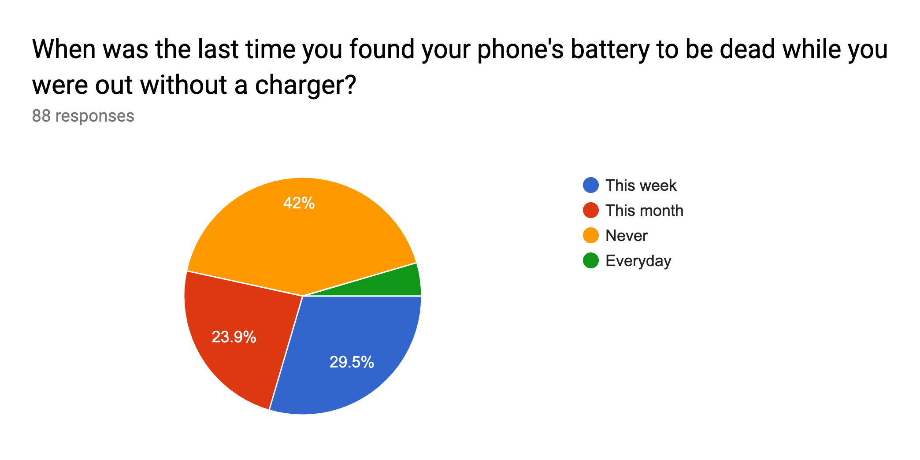

Slide 9
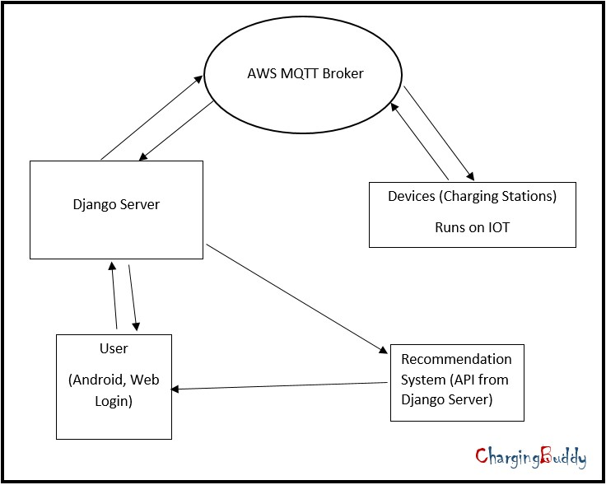
Proposed System

Slide 10
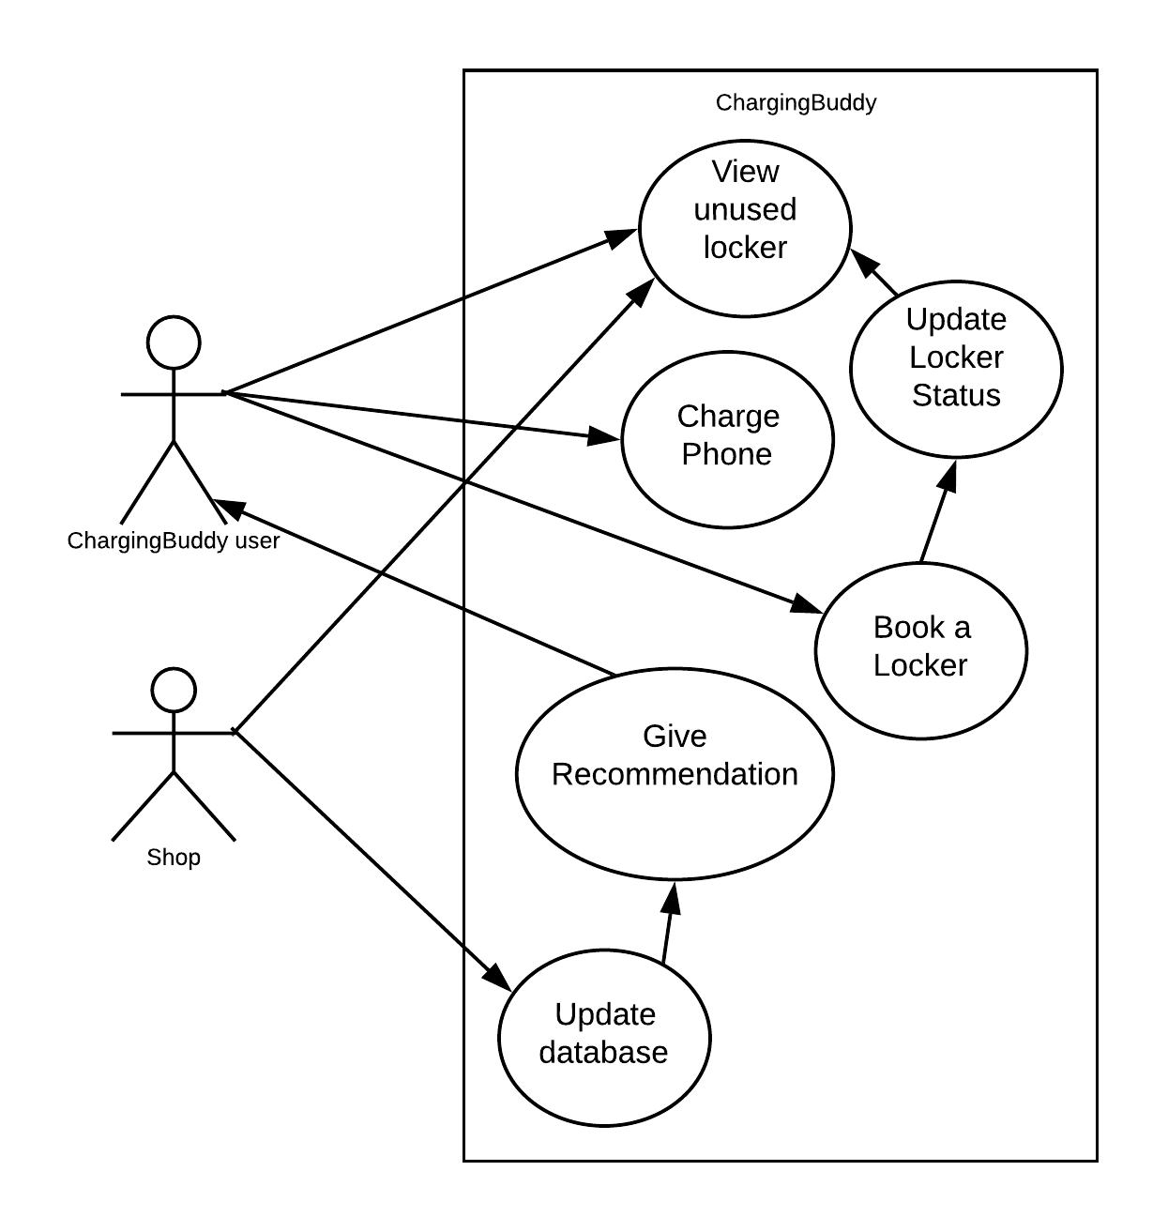
Use Case Diagram

Slide 11
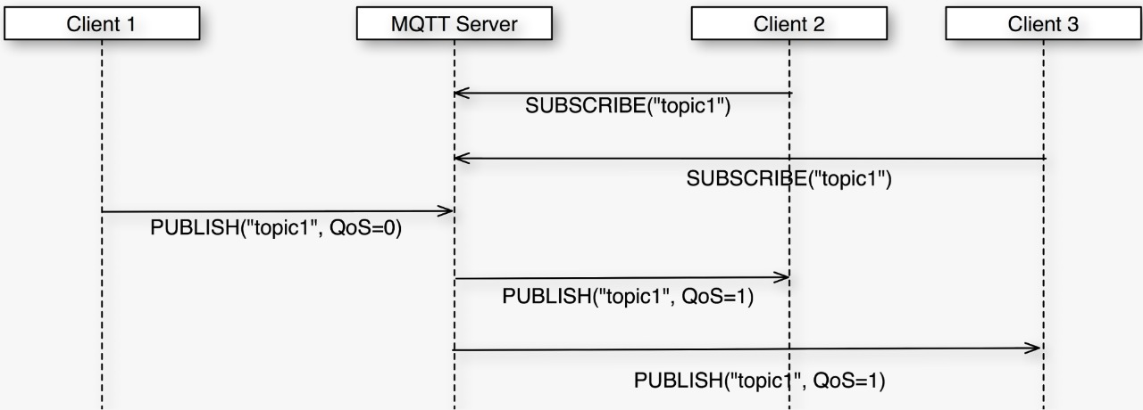

MQTT Sequence Diagram

Slide 12
Implementation
Login
Maps showing charging stations on Web & Android application
Checking of locker status on Web & Android application
Advertisement Page on Charging Station Screen
Booking through Charging station screen
3D model of Charging station
Working prototype of Charging station

Slide 13
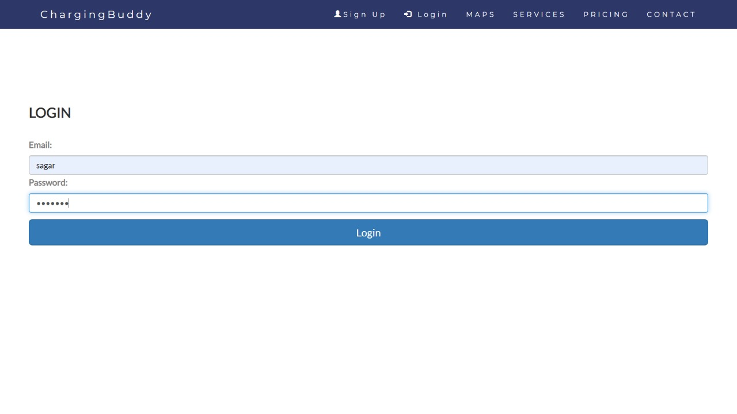
Login

Slide 14
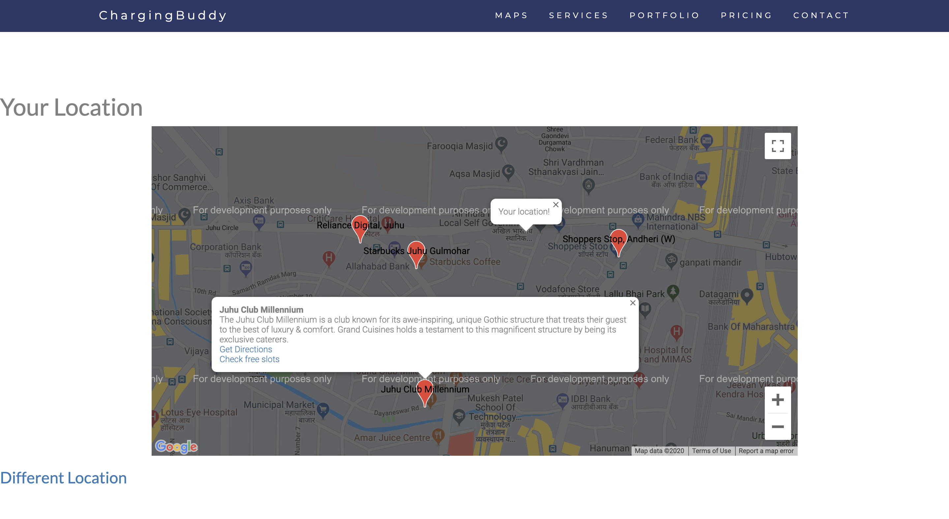
Maps
This is implemented using Google Maps JavaScript API.
Users would use this for browsing the nearby Charging stations.

Slide 15
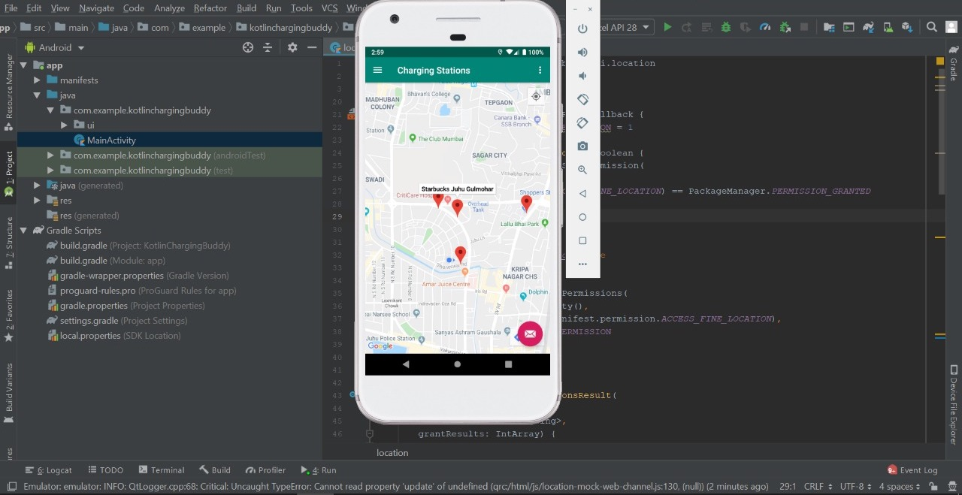
Maps on Android App

Slide 16
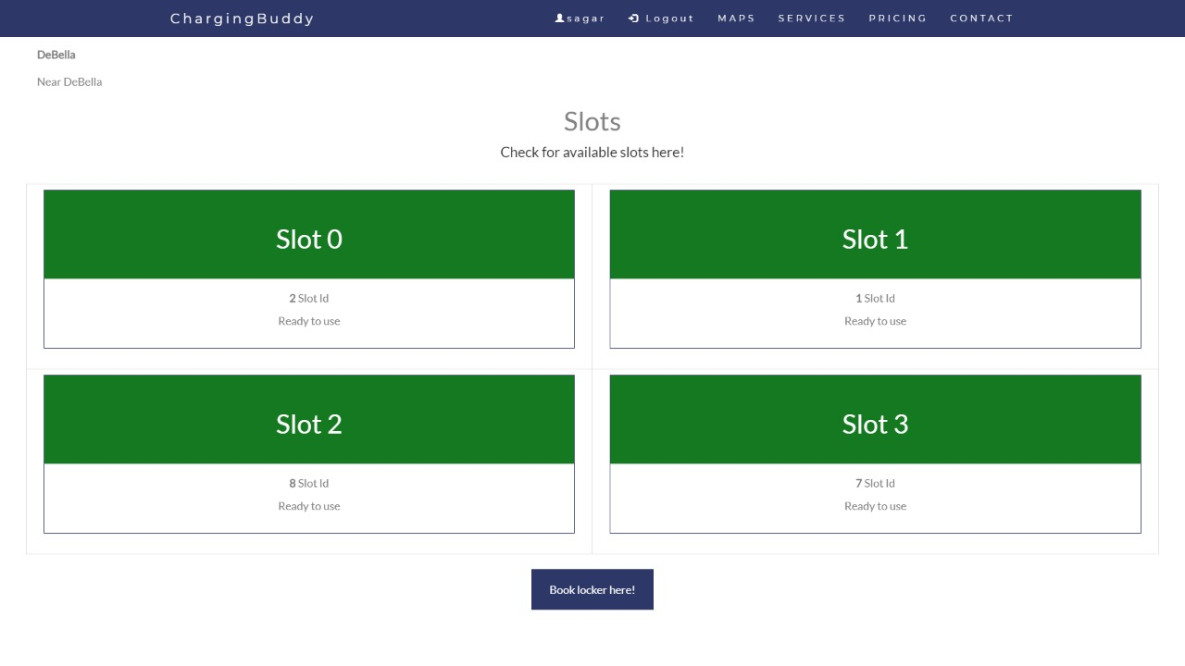
Checking the status of lockers at Charging Station

Slide 17
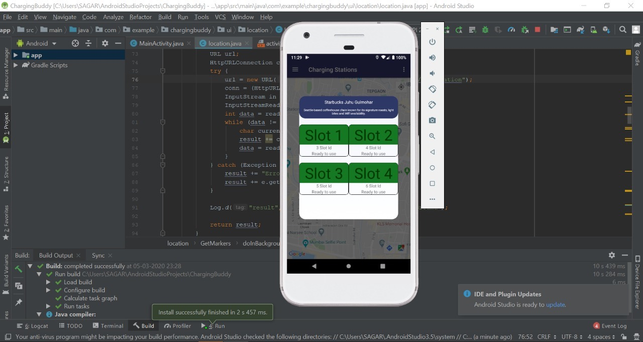
Checking the status of lockers at Charging Station

Slide 18
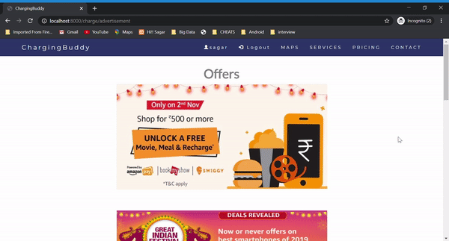
Advertisements page displayed on Charging station screen

Slide 19
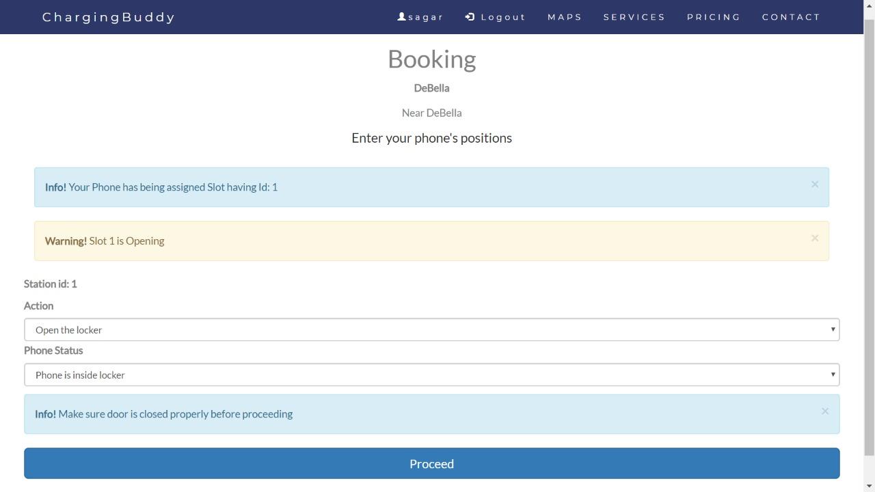
UI on the Charging Station Screen

Slide 20
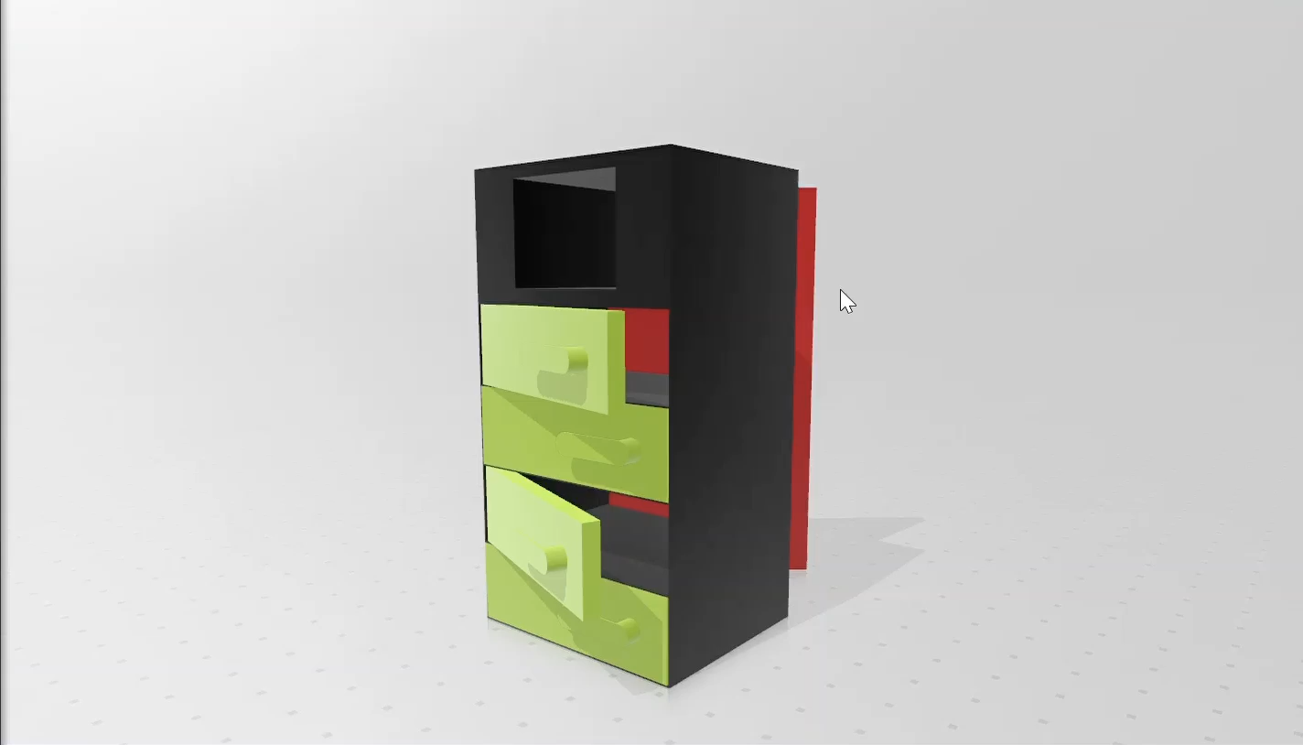
3D Model of our Charging Station

Slide 21


Working Prototype

Slide 22
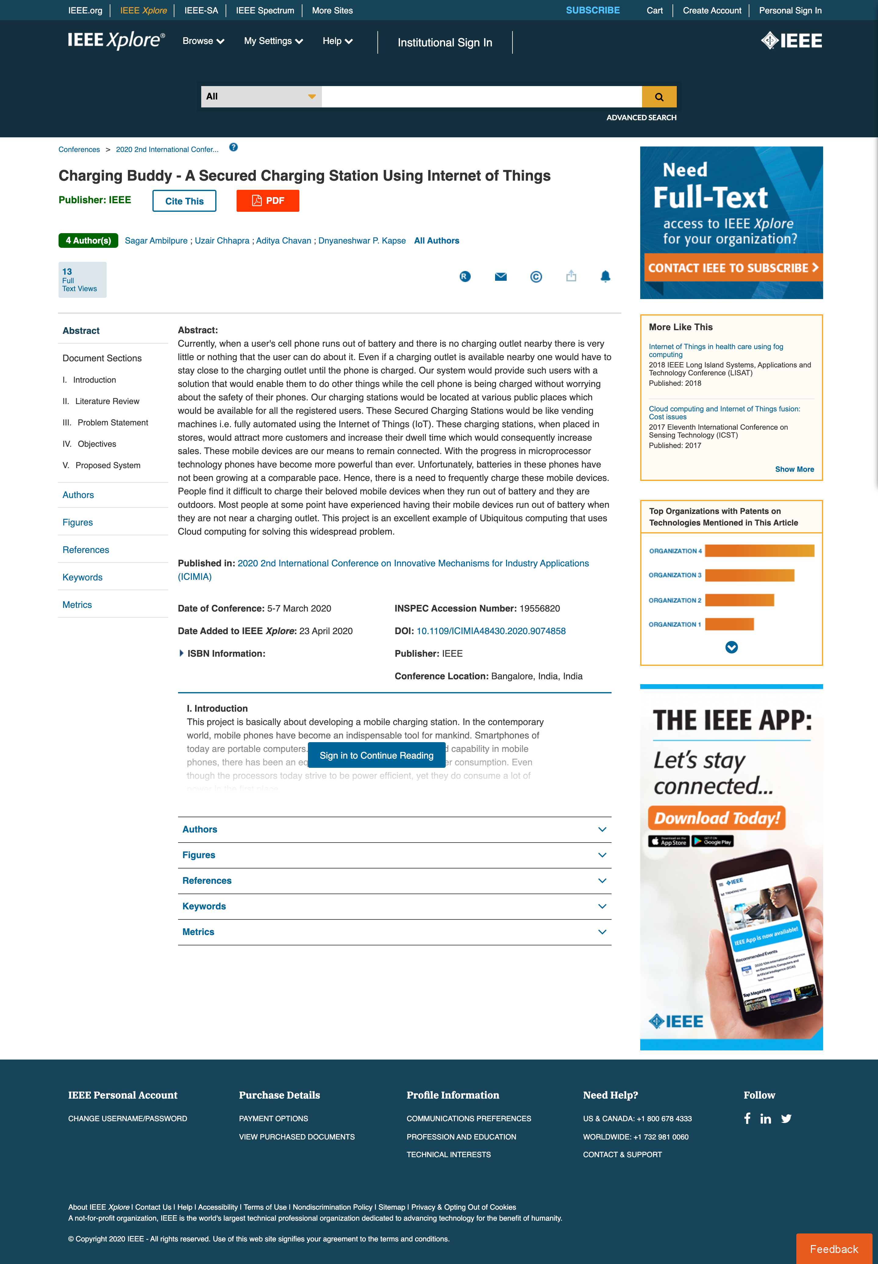
Paper Published
A paper based on this project titled “ChargingBuddy – A Secured Charging Station Using Internet Of Things” has been presented at the 2nd International Conference on Innovative Mechanisms for Industry Applications (ICIMIA) 2020 (ISBN: 978-1-7281-4167-1) and is published in IEEE Xplore.
Link: https://ieeexplore.ieee.org/document/9074858

Slide 23


Details of Hardware & Software
Django for server
Raspberry Pi
Electric lock
AWS IOT core
Google Maps SDK
Android Studio

Slide 24

References
M.S.Varadarajan, Veltech Dr. RR, Dr.SR Technical University Chennai, India - Coin Based Universal Mobile Battery Charger IOSR Journal of Engineering (IOSRJEN), ISSN: 2250-3021 Volume 2, Issue 6 (June 2012), PP 1433-1438.
E. Rammohana Reddy, K. Sankara, Analyzing Consumerization - Internet of Things Based Home Automation Control System Using Raspberry Pi International Journal of Scientific Research in Computer Science, Engineering and Information Technology, 2018 IJSRCSEIT — Volume 3 — Issue 4 — ISSN : 2456-3307.
Deepak B. Andore - AWS IOT Platform based Remote Monitoring by using Raspberry Pi International Journal of Latest Technology in Engineering, Management Applied Science (IJLTEMAS) , Volume VI, Issue X, October 2017 — ISSN 2278-2540.
Nareshkumar R. M., Apoorva Kamat, Dnyaneshvari Shinde - Smart Door Security Control System Using Raspberry Pi ,’ proceeding of the International Journal of Innovations Advancement in Computer Science , 6, Issue 11 November 2017.
Prof. B Nithya Ramesh, Aashay R Amballi, Vivekananda Mahanta - DJANGO THE PYTHON WEB FRAMEWORK International Journal of Computer Science and Information Technology Research , Vol. 6, Issue 2, pp: (59-63), Month: April - June 2018.

Slide 25
References
Bajorek, Marcin, and Jedrzej Nowak - ”The role of a mobile device in a home monitoring healthcare system, Computer Science and Information Systems (Fed- CSIS) , 2011 Federated Conference on. IEEE, 2011.
Tupakula, Udaya, Vijay Varadharajan, and Sunil Kumar Vuppala. - Security Techniques for Beyond 3G Wireless Mobile Networks Embedded and Ubiquitous Computing (EUC), 2011 IFIP 9th International Conference on. IEEE, , 2011.
”Home Automation as a service”, International Journal of Computer Networks and Wireless Communications (IJCNWC), June 2012.
S. Nazeem Basha, Dr. S.A.K. Jilani - An Intelligent Door System using Rasp- berry Pi and Amazon Web Services IoT International Journal of Engineering Trends and Technology (IJETT), vol. 33, pp. 84- 89,2016.
Rajendra Nayak, Neema Shetty - Secured Smart Home Monitoring System Using Raspberry-PI, International Journal Innovative Research and Development (IJIRD), vol. 5, pp. 339-342,2016.
Google Maps Javascript API Online Documentation: https://developers.google.com/maps/documentation/javascript/tutorial
Google Maps SDK for Android Online Documentation: https://developers.google.com/maps/documentation/android-sdk/intro

Slide 26

Thank you!

